Slide 1
Software Requirements Engineering
Lecture11-12
Engr. Sara Rehmat

Slide 2
Requirements Elicitation
The heart of requirements development is elicitation,
The process of identifying the needs and constraints of the various stakeholders for a software system.
Elicitation is not the same as “gathering requirements” nor is it a simple matter of transcribing exactly what users say.
Elicitation is a collaborative and analytical process that includes activities to collect, discover, extract, and define requirements.
Elicitation is used to discover business, user, functional, and non-functional requirements, along with other types of information.

Slide 3
Requirements Elicitation
To facilitate clear communication, use the vocabulary of the business domain instead of forcing customers to understand technical jargon.
Record significant application domain terms in a glossary, rather than assuming that all participants share the same definitions.
Customers must understand that a discussion about possible functionality is not a commitment to include it in the product.
The output of requirements development is a common understanding of the needs held by the diverse project stakeholders.
When the developers understand those needs, they can explore alternative solutions to address them.
Elicitation participants should resist the temptation to design the system until they understand the problem.
Otherwise, they can expect to do considerable design rework as the requirements become better defined.

Slide 4
Requirements Elicitation
The nature of requirements development is cyclic.

Slide 5
Requirements Elicitation Techniques
Numerous elicitation techniques can be employed on software projects.
No project team should expect to use only one elicitation technique.
There are always many types of information to be discovered, and different stakeholders will prefer different approaches.
Elicitation techniques include
Facilitated activities, in which you interact with stakeholders to elicit requirements,
focus on discovering business and user requirements.
Independent activities, in which you work on your own to discover information.
supplement requirements that users present and reveal needed functionality that end users might not be aware of.
Most projects will use a combination of both facilitated and independent elicitation activities.

Slide 6
Requirements Elicitation Techniques
Interviews
Workshops
Focus Groups
Observations
Questionnaires
Interface Analysis
User Interface Analysis
Document Analysis

Slide 7
1. Interviews
Interviews are a traditional source of requirements input for both commercial products and information systems, across all software development approaches.
Agile projects make extensive use of interviews as a mechanism to get direct user involvement.

Slide 8
1.1 Suggestions for conducting Interviews
Establish rapport
Stay in scope
Prepare questions and straw man models ahead of time
Suggest ideas

Slide 9
2. Workshops
Workshops are facilitated sessions with multiple stakeholders and formal roles, such as a facilitator and a scribe.
Workshops often include several types of stakeholders, from users to developers to testers.
They are used to elicit requirements from multiple stakeholders concurrently.
Working in a group is more effective for resolving disagreements than is talking to people individually.

Slide 10
2. Workshops
When a team is getting started with new approaches to requirements elicitation, consider having an outside facilitator or a second BA facilitate the initial workshops.
This way the lead BA can devote his full attention to the discussion.
If the sole BA is also acting as facilitator, she needs to be mindful of when she is speaking as a facilitator and when she is participating in the discussion.
A scribe assists the facilitator by capturing the points that come up during the discussion.

Slide 11
2. Workshops
Workshops can be resource intensive, sometimes requiring numerous participants for several days at a time.
They must be well planned to avoid wasting time.
Minimize wasted time by coming into a workshop with drafts of materials prepared ahead of time

Slide 12
2.2 Suggestions for conducting Workshops
Establish and enforce ground rules
Fill all of the team roles
Plan an agenda
Stay in scope
Timebox discussions
Keep the team small but include the right stakeholders

Slide 13
3. Focus groups
A focus group is a representative group of users who convene in a facilitated elicitation activity to generate input and ideas on a product’s functional and quality requirements.
They are particularly valuable if you are developing commercial products and don’t have ready access to end users within your company.
Focus groups must be facilitated.
You will need to keep them on topic, but without influencing the opinions being expressed.
You might want to record the session so you can go back and listen carefully to comments.
Participants

Slide 14
4. Observations
When you ask users to describe how they do their jobs, they will likely have a hard time being precise—details might be missing or incorrect.
Often this is because tasks are complex and it’s hard to remember every minute detail.
In other cases, it is because users are so familiar with executing a task that they can’t articulate everything they do.
Observations are time consuming, so they aren’t suitable for every user or every task.
To avoid disrupting the users’ regularly assigned work activities, limit each observation time to two hours or less.
Select important or high-risk tasks and multiple user classes for observations.
If

Slide 15
4. Observations
Observations can be silent or interactive.
Silent observations are appropriate when busy users cannot be interrupted.
Interactive observations allow the BA to interrupt the user mid-task and ask a question.
Document what you observe for further analysis after the session.

Slide 16
5. Questionnaires
Questionnaires are a way to survey large groups of users to understand their needs.
They are inexpensive and can be administered easily across geographical boundaries.
The analyzed results of questionnaires can be used as an input to other elicitation techniques.
For example, you might use a questionnaire to identify users’ biggest pain points with an existing system, then use the results to discuss prioritization with decision makers in a workshop.
You can also use questionnaires to survey commercial product users for feedback.

Slide 17
5.1 Suggestions for making efficient questionnaires
Provide answer options that cover the full set of possible responses.
Make answer choices both mutually exclusive (no overlaps in numerical ranges) and exhaustive (list all possible choices and/or have a write-in spot for a choice you didn’t think of).
Don’t phrase a question in a way that implies a “correct” answer.
If you use scales, use them consistently throughout the questionnaire.
Use closed questions with two or more specific choices if you want to use the questionnaire results for statistical analysis. Open-ended questions allows users to respond any way they want, so it’s hard to look for commonalities in the results.
Consider consulting with an expert in questionnaire design and administration to ensure that you ask the right questions of the right people.
Always test a questionnaire before distributing it. It’s frustrating to discover too late that a question was phrased ambiguously or to realize that an important question was omitted.
Don’t ask too many questions or people won’t respond.

Slide 18
6. Interface Analysis
Interface analysis is an independent elicitation technique that entails examining the systems to which your system connects.
System interface analysis reveals functional requirements regarding the exchange of data and services between systems
Context diagrams and ecosystem maps are an obvious choice to begin finding interfaces for further study.
Suppose you thought you needed to implement validation rules for a shopping-cart order in an e-commerce website before passing it to an order-management system.
Through system interface analysis, you might learn that multiple systems pass orders to the order-management system, which performs the validation, so you don’t need to build this function.

Slide 19
7. User Interface Analysis
User interface (UI) analysis is an independent elicitation technique in which you study existing systems to discover user and functional requirements.
It’s best to interact with the existing systems directly, but if necessary you can use screen shots.
By navigating the existing UI, you can learn about the common steps users take in the system and draft use cases to review with users.
It’s a great way to get up to speed on how an existing system works Instead

Slide 20
8. Document Analysis
Document analysis entails examining any existing documentation for potential software requirements.
When replacing an existing system, past documentation can reveal functionality that might need to be retained, as well as obsolete functionality.
Comparative reviews point out shortcomings in other products that you could address to gain a competitive advantage.
Problem reports and enhancement requests collected from users by help desk and field support personnel can offer ideas for improving the system in future releases.
A risk with this technique is that the available documents might not be up to date.

Slide 21
Planning Elicitation
Early in a project, the business analyst should plan the project’s approach to requirements elicitation.
Elicitation objectives
Elicitation strategy and planned techniques
Schedule and resource estimates
Documents and systems needed for independent elicitation
Expected products of elicitation efforts
Elicitation risks

Slide 22
Requirements Analysis

Slide 23
Understanding User Requirements

Slide 24
Approaches for gathering User Requirements
To gather user requirements, there are two approaches.
Product-centric approach
User-centric and usage-centric approach
Product-centric approach
Focuses on defining the features to implement in the software, with the hope that those features will appeal to prospective customers.
User-centric and usage-centric approach
Focusing on users and their anticipated usage helps reveal the necessary functionality, avoids implementing features that no one will use, and assists with prioritization.
Two techniques used are : Use Cases and User Stories
Difference:
what users need to accomplish
asking users what they want the system to do.

Slide 25
Applications of User-centered approach
Use cases and user stories work well for exploring the requirements for
business applications, websites, kiosks, and systems that let a user control a piece of hardware.
Use cases or user stories are inadequate for understanding the requirements of certain types of applications.
batch processes, computationally intensive systems, business analytics, and data warehousing, many embedded and other real-time systems.
The complexity of these applications lies in the computations performed, the data found and compiled, or the reports generated, not in the user-system interactions.

Slide 26
Use Case
A use case describes a sequence of interactions between a system and an external actor that results in the actor being able to achieve some outcome of value.
The names of use cases are always written in the form of a verb followed by an object.
Select strong, descriptive names to make it evident from the name that the use case will deliver something valuable for some user.

Slide 27
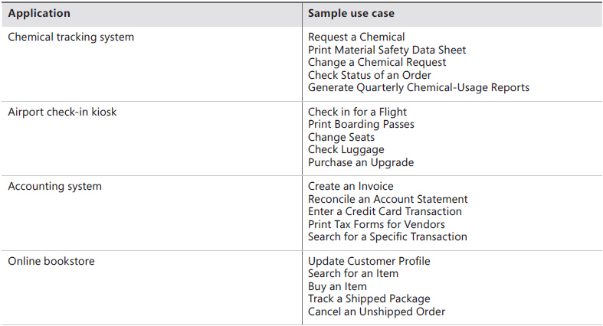
Examples of Use Cases

Slide 28
User Story
Used on agile development projects,
A “short, simple description of a feature told from the perspective of the person who desires the new capability, usually a user or customer of the system” (Cohn 2010).
User stories often are written according to the following template, although other styles also are used:
As a <type of user>, I want <some goal> so that <some reason>.

Slide 29
